Slide 1


Slide 2
What is Apache Flink?
It is an open source stream-processing framework developed by Apache Software Foundation.

Slide 3


ORIGIN
1.Started at 2009 in Berlin based database
research group
2.In December 2014,Flink was
accepted as a Apache top-level project

Slide 4

FEATURES
1. Streaming - Flink is a true stream processing engine.
2.High performance - Flink’s data streaming Runtime provides very high throughput.
3.Low latency- Flink can process the data in sub-second range without any delay.

Slide 5

4.Memory management – Flink works in managed memory and never get out of memory exception.
5.Scalable – Flink is highly scalable. With increasing requirements, we can scale the flink cluster.
6.Program optimizer – Flink is shipped with an optimizer, before execution of a program it is optimized.

Slide 6
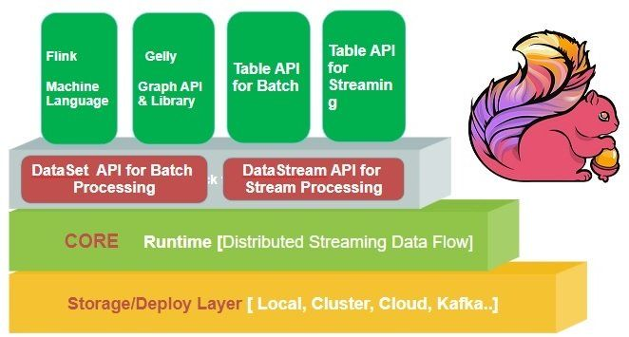
Apache Flink Ecosystem

Slide 7

Different layers in the ecosystem are -
i. Storage / Streaming
List of storage/streaming system from which Flink
can read write data:
> HDFS – Hadoop Distributed File System
> Local-FS – Local File System
> RDBMS – Any relational database

Slide 8
Deployment/resource management
Local mode – On a single node, in single JVM
Cluster – On a multi-node cluster, with following resource manager.
Standalone – This is the default resource manager which is shipped with Flink.
YARN – This is a very popular resource manager, it is part of Hadoop, introduced in Hadoop 2.x
Cloud – on Amazon or Google cloud

Slide 9
The APIs and Library, which provides the diverse capability to Flink:
i.DataSet API
It handles the data at the rest, it allows the user to implement many operations on the dataset. It is mainly used for distributed processing. Actually, it is a special case of Stream processing where we have a finite data source.
ii.DataStream API
It handles a continuous stream of the data. It can consume the data from the various streaming source and can write the data to different sinks. It supports both Java and Scala.

Slide 10
iii. Table
It enables users to perform ad-hoc analysis using SQL like expression language for relational stream and batch processing.
iv. Gelly
It is the graph processing engine which allows users to run set of operations to create, transform and process the graph.
v. FlinkML
It is the machine learning library which provides intuitive APIs and an efficient algorithm to handle machine learning applications

Slide 11

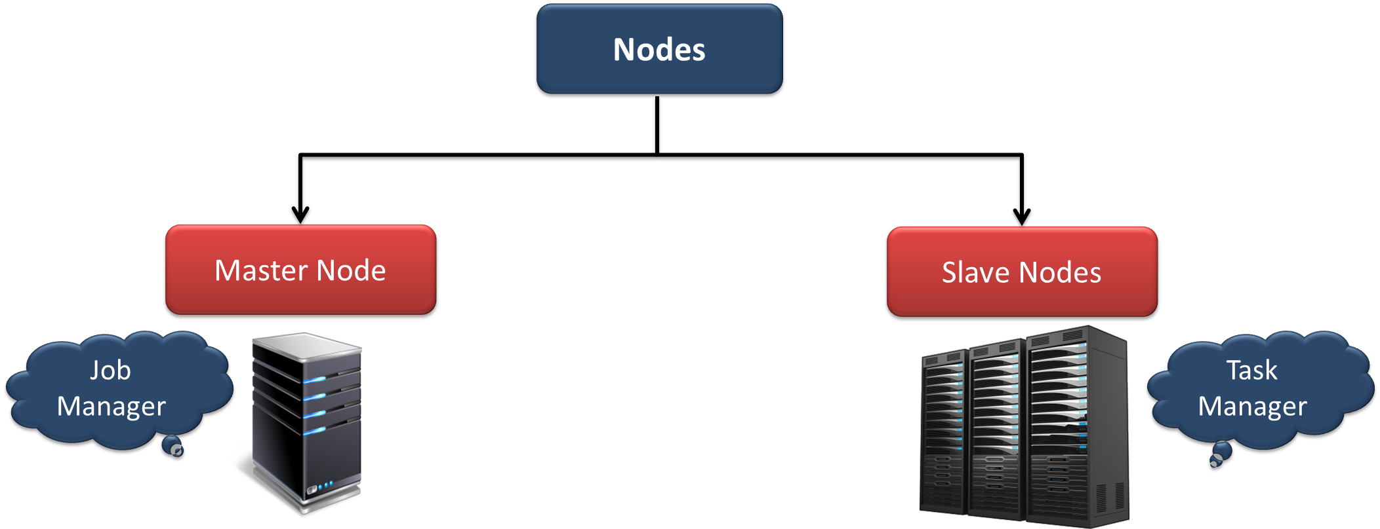
ARCHITECTURE
Flink works in Master-slave fashion. Master is the manager node of the cluster where slaves are the worker nodes.

Slide 12
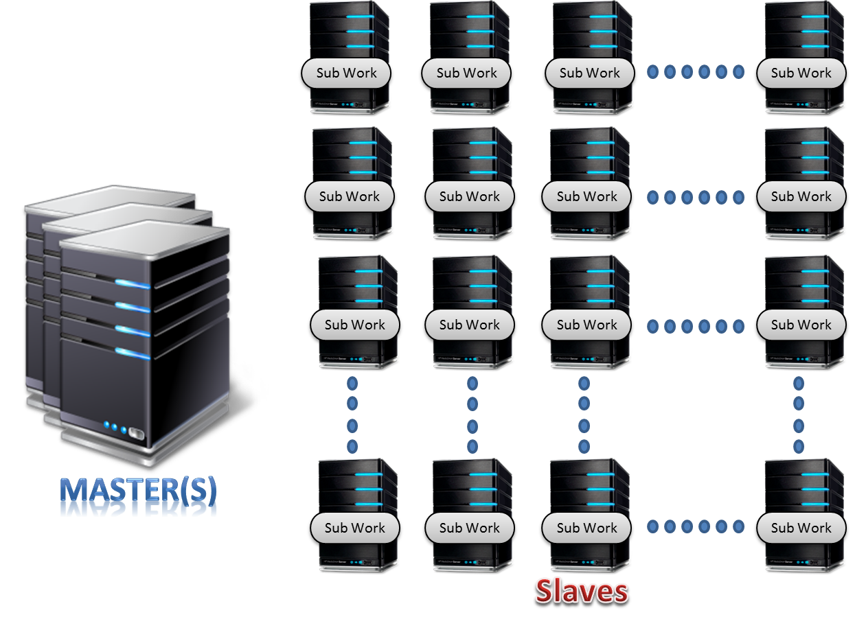

Slide 13
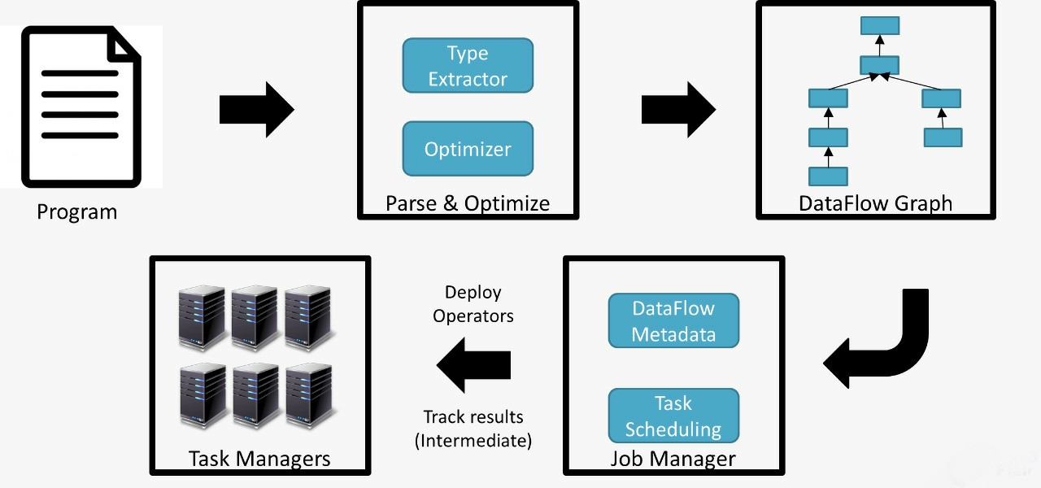
EXECUTION MODEL

Slide 14
As shown in the figure the following are the steps to execute the applications in Flink:
Program – Developer wrote the application program.
Parse and Optimize – The code parsing, Type Extractor, and Optimization are done during this step.
DataFlow Graph – Each and every job converts into the data flow graph.
Job Manager – Now job manager schedules the task on the task managers; keeps the data flow metadata. Job manager deploys the operators and monitors the intermediate task results
Task Manager – The tasks are executed on the task manager, they are the worker nodes.

Slide 15
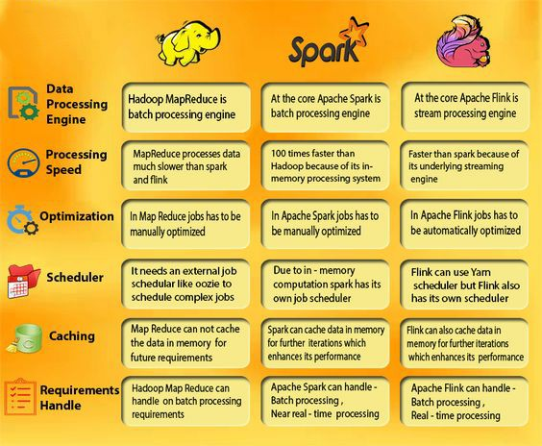

Slide 16

SECURITY
Security is provided through SSL authentication and encryption for network communication with and between Flink processes.
The SSL configuration requires to configure a keystore and a truststore

Slide 17
APPLICATIONS
Fraud detection->real time
Recommendation of offers by help of browsering history->real time
Web application
Business process monitoring

Slide 18




LIST OF COMPANIES POWERED BY FLINK

Slide 19

INSTALLATION
Check the version of java
Command: java -version
If you have Java 8, the output will look something like this:
java version "1.8.0_111"
Java(TM) SE Runtime Environment (build 1.8.0_111-b14)
Java HotSpot(TM) 64-Bit Server VM (build 25.111-b14, mixed mode)
.Download tar file of apache flink "https://www.apache.org/dyn/closer.lua/flink/flink-1.9.0/ flink-1.9.0-bin-scala_2.11.tgz"

Slide 20
tar xzf flink-1.9.0-bin-scala_2.11..tgz
cd flink-1.9.0
./bin/start-cluster.sh # Start Flink
jps
Open the local-host in browser:
localhost:8081

Slide 21
THANK YOU

